Slide 1
Google Cloud Dataflow POC - Read from GS and Write to BQ
Jayaprakash

Slide 2
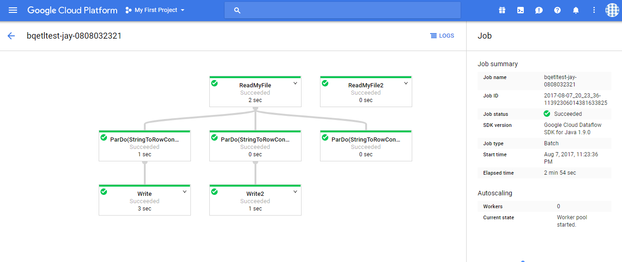

Slide 3
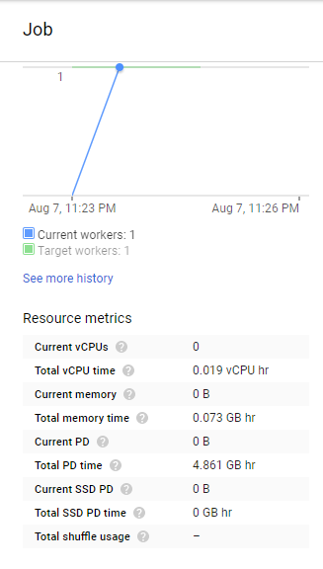
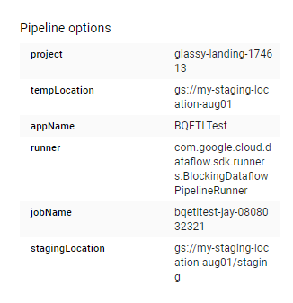

Slide 4
